Slide 1

SRC –Serving Industry Needs
Highlighting Export Services
July 2016

Slide 2

SRC - Fulfills Its Mandate by:
Supports growth and development of the agro-industrial Sector in Jamaica through:
  Research & Development
  Adaptation of Available Technologies
Protocols & Formulations
Training; Process & Product Improvement
Technology Transfer
Technical Assistance
Food Processing/ Incubator Services
Popularization of Sc. and Technology

Slide 3
SRC a Catalyst!!
PRELIMINARY (market Driven) | Techno/Market Intelligence; consultancy services
FARM | Clean Planting Material via Tissue Culture (food & ornamental
MANUFACTURING | High value-added options; novel products
SERVICES | Training; Food Incubator; Information; Analytical lab -(food & water), Wastewater Treatment; Tech. Transfer

Slide 4
Available
Technologies & Services for
Viable Businesses/ Export

Slide 5
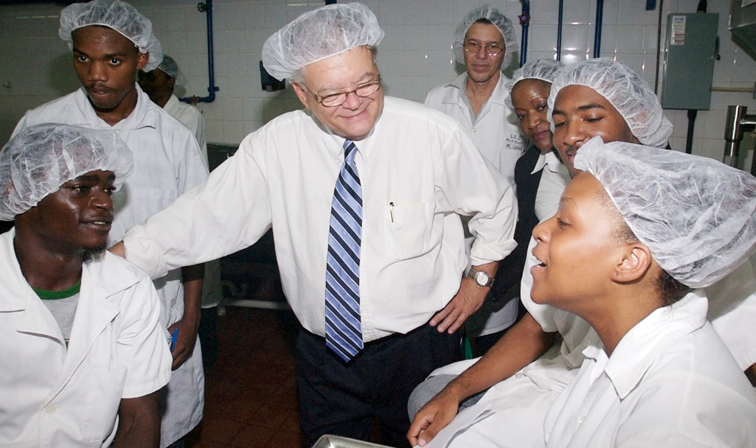
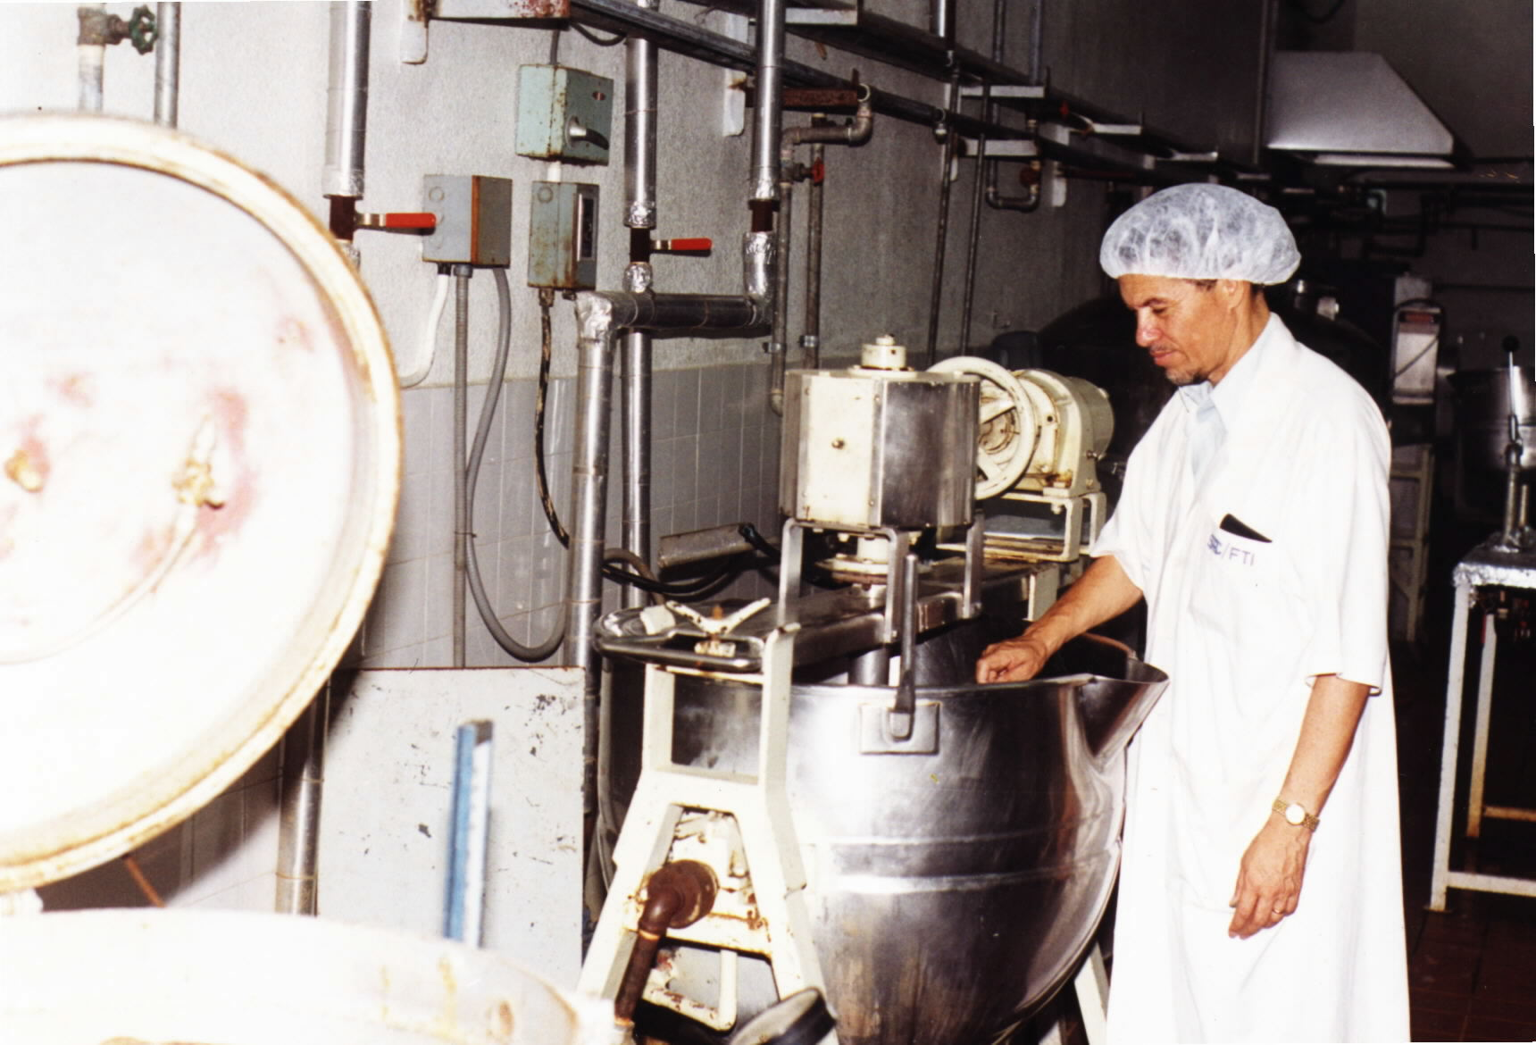
FOOD Technologies
Canning
Dehydration
Extraction
Milling
Blending & Mixing
Extrusion
Training & Consultancy Services

Slide 6
FOOD SERVICES
New Product Development
Product Standardization
Process Improvement
Labeling (JA., UK, USA, Canada) standards
Shelf Life Studies
Sensory Analysis
Nutrition Analysis – e.g. total fat, protein
Scheduled (Thermal) Processing

Slide 7
Food Services (contd)
Microbiology Services (food safety & quality) – water & food e.g. yeast & mould count;
Trouble Shooting – e.g. ascertain cause for food spoilage
Plant Layout
Equipment Guide
Selection & use Appropriate Packaging

Slide 8
WASTEWATER
Wastewater Treatment Systems - anaerobic technology
Cost Effective; minimal maintenance
Byproducts - Biogas - alternate energy; treated wastewater; organic fertilizer
Patents:
  Biodigester Septic Tank (BSTTM)
  AWL and Impoundments
Services - Feasibility studies; engineering designs; commissioning; training

Slide 9
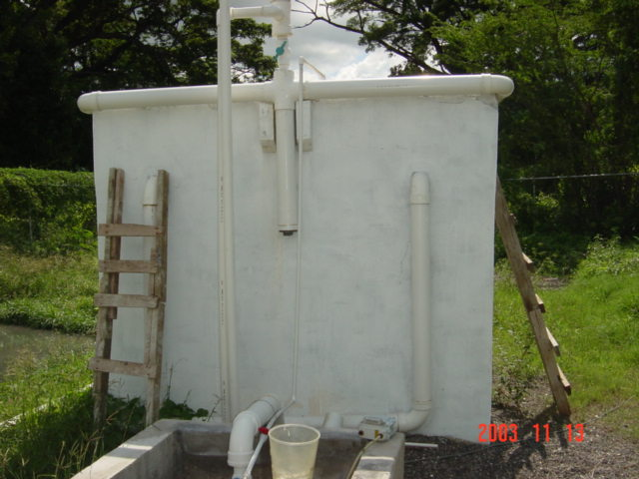
Treating Cassava Waste

Slide 10
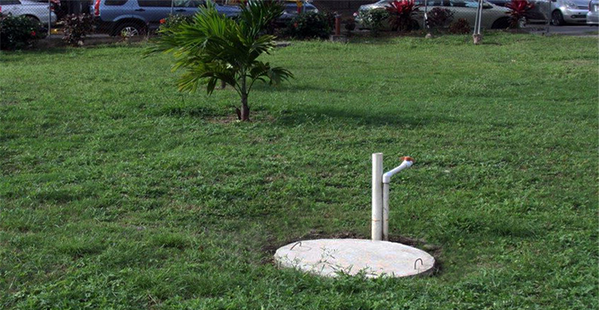
Treating Sewage – Organic Waste
BST under construction
Completed BST

Slide 11
Green Technology
Increase market demand for food and processes that utilize environmentally friendly technologies
Cleaner Production Technologies
  Waste elimination or reduction
  Optimize productivity and efficiency
  Impacts bottom line

Slide 12
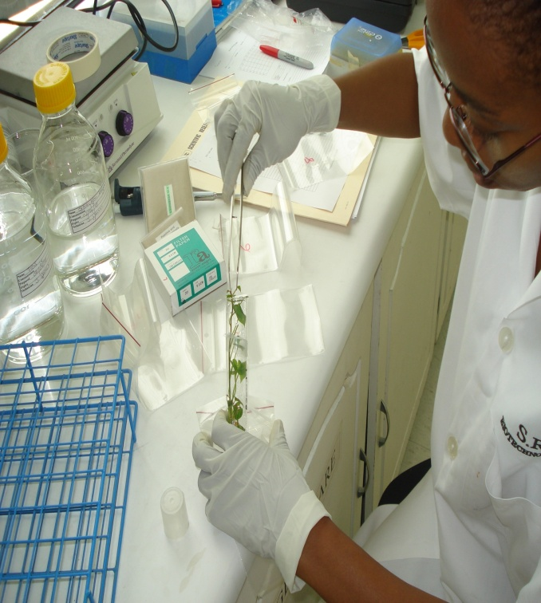
PLANT BIOTECHNOLOGY
Provision of disease free tissue cultured plantlets in flexible economic quantities
Micro-propagation of plants
Development of protocols
(for growth room facilities)
Diagnostic tests
(banana, plantain, ginger)
Training

Slide 13
Services to Increase Market Competitiveness
HACCP – Hazard Analysis & Critical Control Points
GMP – Good Manufacturing Practices
COA - Certificate of Analysis
FDA – Food & Drug Administration –compliance with processing requirements
Certification Mark – quality mark
Accredited Laboratories – ISO 17025

Slide 14
HAACP Services
SRC’s Internationally Certified Consultants:
Assist companies to implement HAACP - international food safety system.
Conduct Gap Audits
Develop Corrective Action Plans
Documentation – plans; procedures; infrastructure changes
Training of staff

Slide 15
Certificate Of Analysis (COA)
What is COA?
Authenticated document that speaks to the quality and origin of the product
Major Benefits
Increase customer confidence & sales
Provides information on actives e.g. Ginger: Zingerberine – flavour ; Gingerol – pungency
Service - COA for herbs and spices

Slide 16

Product Development Initiatives
Flavoured Water
Natural Juices
Roots & Energy Drink
Minimally Processed Foods
Seasonings & Sauces
Lemongrass – beverages, personal care products

Slide 17

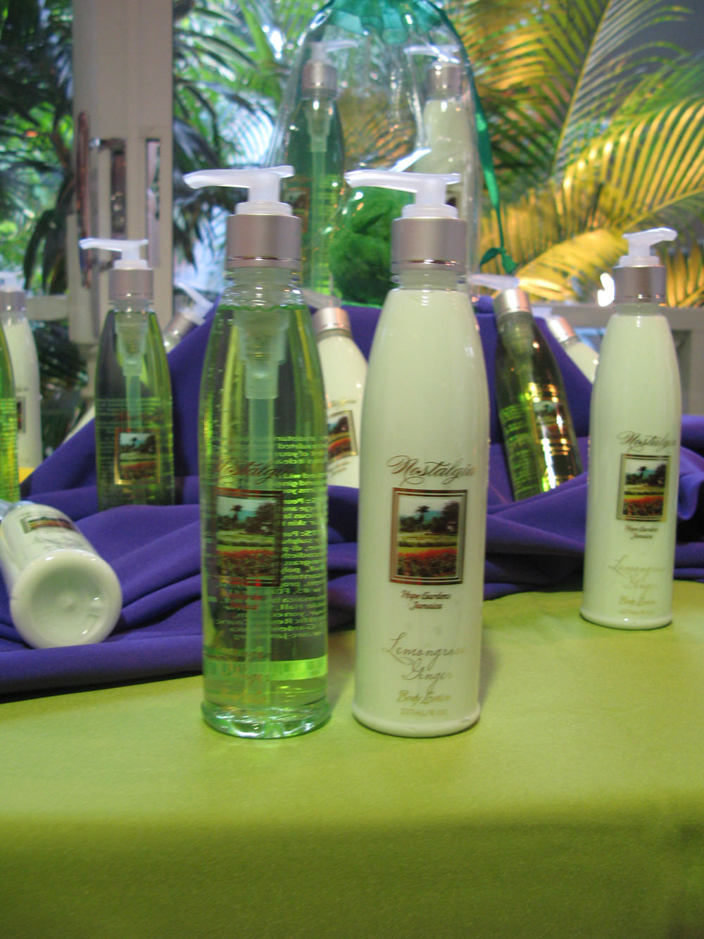
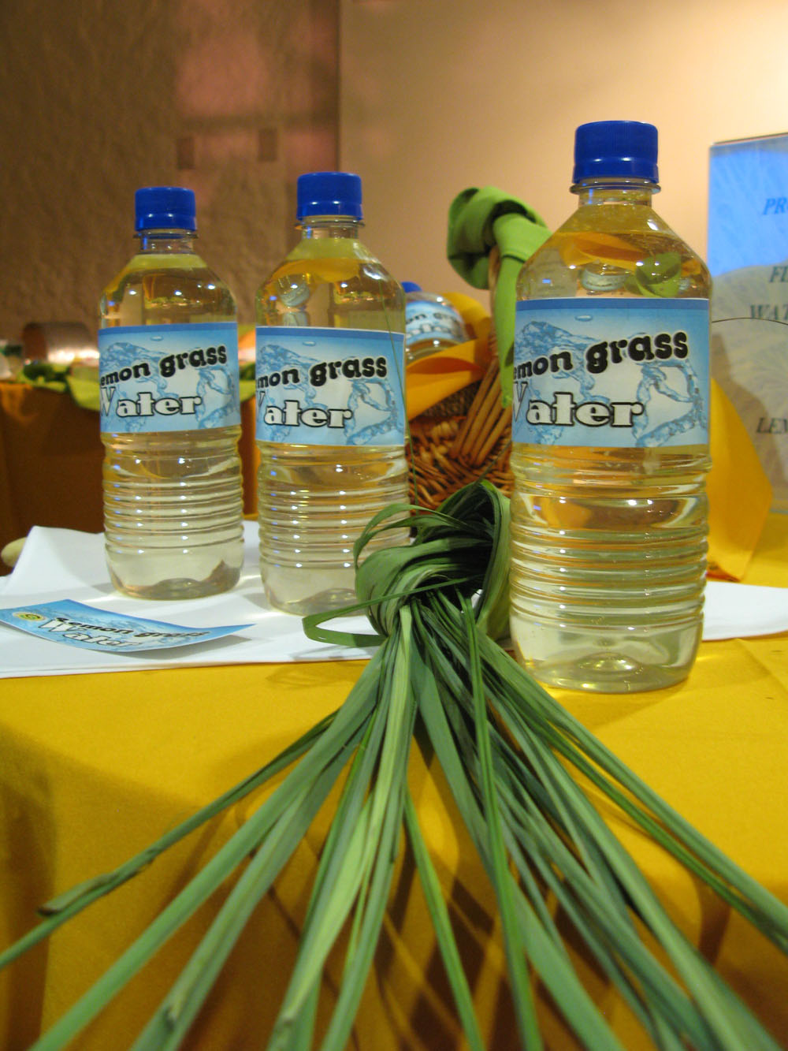
Lemongrass Value-Added Products

Slide 18
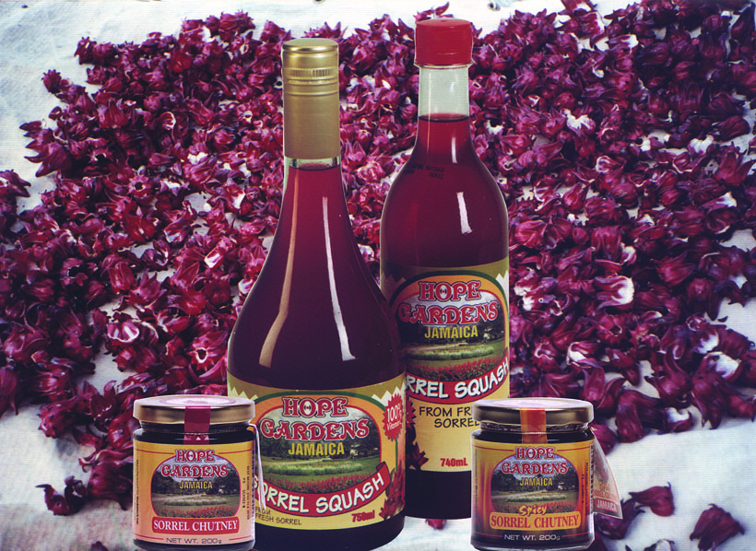
Product Development Initiatives
Ackee & Salt-fish Spread
Condiments - Jams & jellies
Sorrel
Sweet Potato – Beverage;
Pudding mix
Canned Soups
Herbal Teas
Flavoured Water

Slide 19
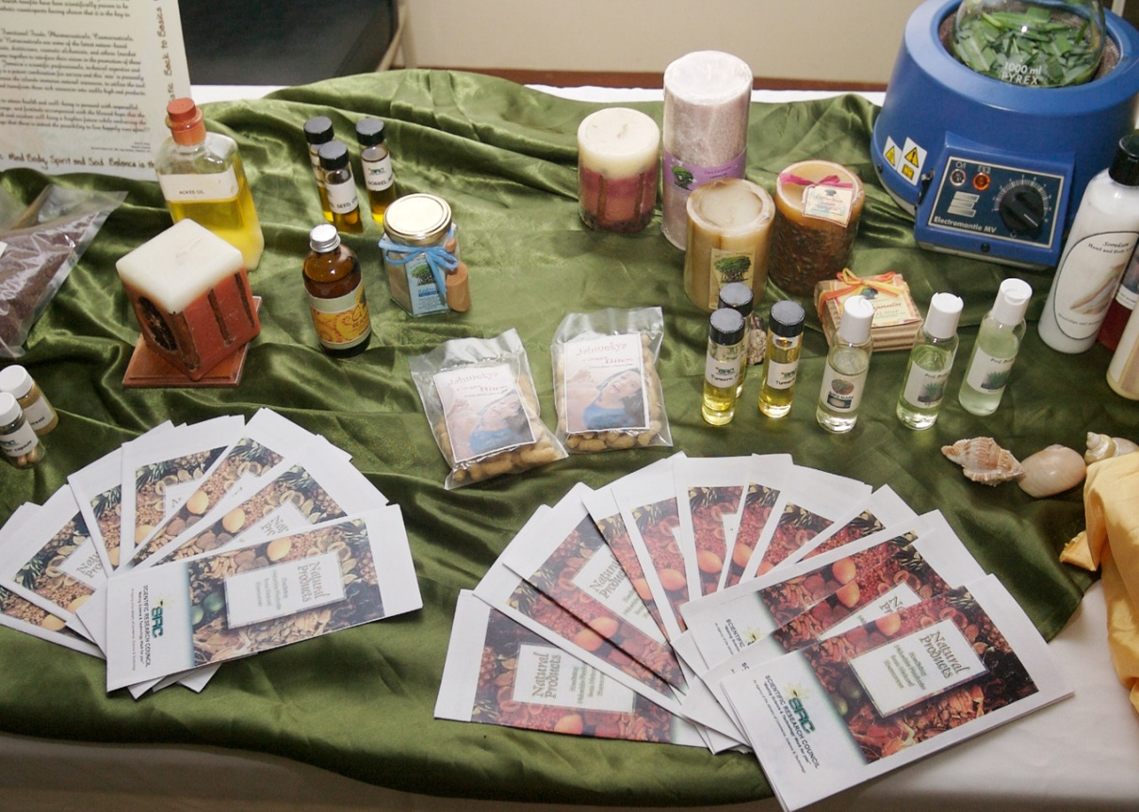

PERSONAL CARE PRODUCTS/
Essential Oils
Lotion
Body-wash
Scrubs
Soaps
Creams
Technical Advice
Extraction of oil & hydrosol

Slide 20



COSMECEUTICALS
Personal care products using local materials with special properties

Slide 21
CRITERIA FOR SRC’s PRODUCT DEVELOPMENT
Local Raw Materials
“High” value-added, novel or exotic
Favourable market potential
Employment opportunity
Income generation opportunity for MSMEs
Available Resources (staff & equipment)

Slide 22
Support Services
Competence in Quality Management System, EMS
Market Research / Price Surveys
“Incubator” Pilot Plant
Documentation Centre
Caribbean Energy Information Services

Slide 23

SRC - ISO 9001 Certified here to serve you!
Let us work with you to impact your bottom-line…
Grow & Earn from your Export Business
prinfo@src-jamaica.org
www.src.gov.jm
THANK YOU !!

